Slide 1
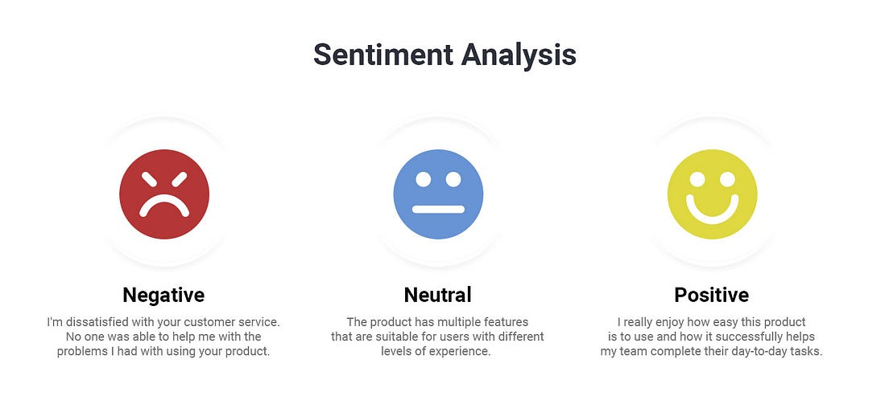
Capstone Project2
Project Domain : E-commerce
Name – Ashish Pachauri

Slide 2
Abstract
This project conducts a comprehensive sentiment analysis on over 34,000 Amazon product reviews, classifying them into positive, negative, and neutral sentiments. The goal is to develop a robust sentiment analysis model that effectively handles class imbalance and leverages both traditional and advanced machine learning techniques.
Key components include:
Data Exploration: Gaining insights into review trends, word usage patterns, and sentiment distribution.
Feature Engineering: Converting textual data into numerical features using TF-IDF vectorization.
Class Imbalance Handling: Applying oversampling and under-sampling strategies to ensure balanced learning.
Model Optimization: Fine-tuning models using Grid Search and Cross-Validation for optimal performance.
Topic Modeling: Identifying hidden themes within reviews through LDA and NMF clustering approaches.
A comparative evaluation of models such as Naive Bayes, SVM, LSTM networks, and XGBoost was performed. Performance metrics including precision, recall, F1-score, and AUC-ROC underscored the effectiveness of the final models.
This project demonstrates how sentiment analysis can enhance understanding of customer feedback and support data-driven decision-making in e-commerce.

Slide 3
Content
1. Introduction
2. Objectives
3. Methods
4. Results
5. Conclusions
Chapter - 1
1. Introduction
This project harnesses natural language processing (NLP) to automate the analysis of over 34,000 Amazon product reviews, focusing on two core objectives: sentiment analysis and topic modeling. The sentiment analysis task involves categorizing reviews as positive, negative, or neutral using a combination of traditional machine learning models (Naive Bayes, Support Vector Machines) and deep learning approaches (Long Short-Term Memory—LSTM networks). Complementing this, topic modeling techniques such as Latent Dirichlet Allocation (LDA) and Non-Negative Matrix Factorization (NMF) are utilized to reveal hidden themes and patterns within the customer feedback.
By integrating these advanced analytical methods, the project delivers automated, unbiased insights into consumer sentiment and discussion topics, enabling data-driven improvements in product targeting and customer engagement strategies

Slide 4
Chapter - 2
2. Objectives:
The primary objectives of this project are as follows:
Analyze Customer Sentiment: Process over 34,000 Amazon product reviews to categorize sentiment as positive, negative, or neutral, providing actionable insights into customer satisfaction and dissatisfaction.
2. Address Class Imbalance: Tackle sentiment class imbalance using oversampling and under-sampling methods to ensure each sentiment category is fairly represented in the training process.
3. Evaluate Diverse Classifiers: Assess and compare the effectiveness of multiple machine learning models—such as Naive Bayes, Support Vector Machines (SVM), and advanced deep learning models like Long Short-Term Memory (LSTM) networks—for accurate sentiment classification.
4. Advance Feature Engineering: Enhance model performance through robust feature engineering, including the calculation of Term Frequency-Inverse Document Frequency (TF-IDF) vectors and the generation of sentiment-based features to boost predictive accuracy.

Slide 5
5. Evaluate Model Performance: Measure classifier effectiveness using metrics such as precision, recall, F1-score, and AUC-ROC, with a particular focus on F1-score to ensure balanced assessment amid class imbalance.
6.Apply Ensemble Techniques: Investigate ensemble models, including XGBoost and hybrid approaches combining algorithms like Multinomial Naive Bayes, to enhance classification performance and further address class imbalance.
7. Incorporate Topic Modeling : Apply techniques such as Latent Dirichlet Allocation (LDA) and Non-Negative Matrix Factorization (NMF) to identify latent topics in reviews and group them into meaningful clusters.
8. Compare Model Approaches: Systematically compare the results of traditional machine learning methods with advanced deep learning frameworks, such as LSTM, to identify the optimal solution for sentiment classification.
9. Optimize Parameters: Employ model optimization strategies, including Grid Search, Random Search, and Cross-Validation, to fine-tune hyperparameters and maximize predictive accuracy.
10. Deliver Actionable Insights: Translate analytical findings into actionable insights for e-commerce stakeholders, highlighting customer preferences, emerging concerns, and levels of satisfaction to inform data-driven strategies and marketing initiatives.

Slide 6
Chapter - 3
3. Methods
(i). Data Collection and Preprocessing:
Dataset Overview:
The dataset consists of over 34,000 Amazon product reviews, each containing attributes such as product name, brand, category, review text, review title, and sentiment label (positive, negative, or neutral). This comprehensive structure enables nuanced analysis across various products and customer sentiments.​
Preprocessing Steps:
1. Text normalization by converting all review content to lowercase, ensuring consistency across the dataset.
2. Removal of special characters, punctuation, and stopwords to eliminate noise and irrelevant elements.
3. Tokenize review text into individual words.
4. Apply stemming and lemmatization to standardize word forms.
(ii). Exploratory Data Analysis (EDA)
A detailed EDA phase uncovers distribution patterns, sentiment proportions, product-specific review trends, and common keywords, setting a solid foundation for effective feature engineering and model selection.

Slide 7
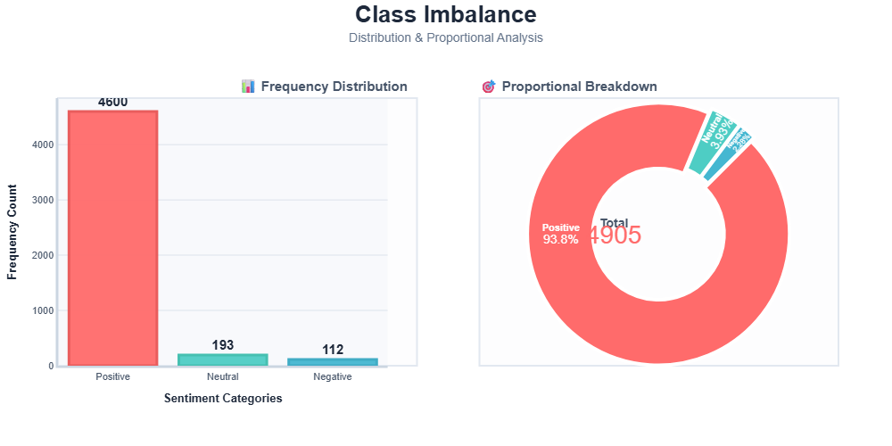
Class Imbalance

Slide 8
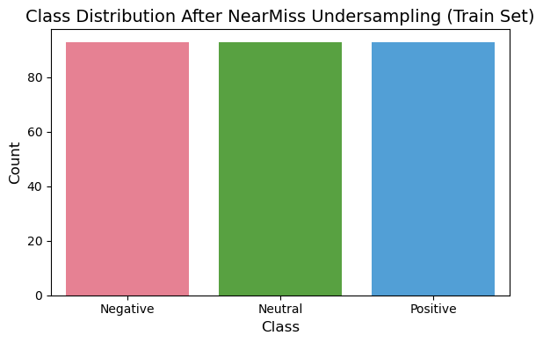
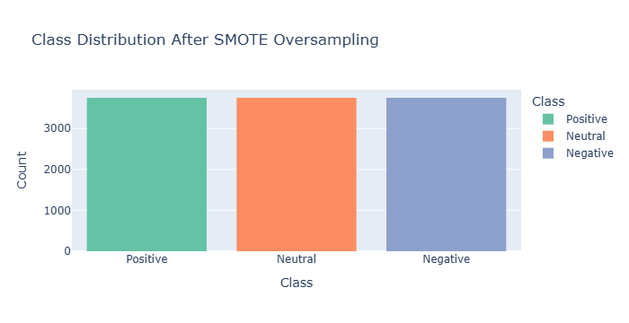
Class Distribution After NearMiss Undersampling (Train Set)
(iii). Class Imbalance Handling:
* Applied oversampling (e.g., SMOTE) and under-sampling techniques.

Slide 9
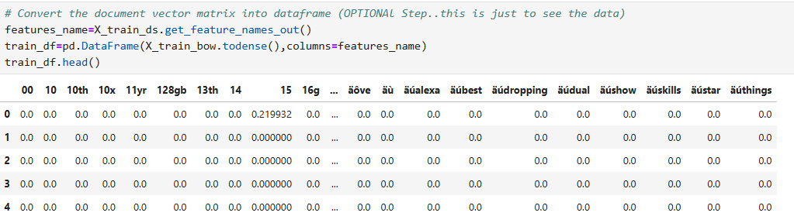
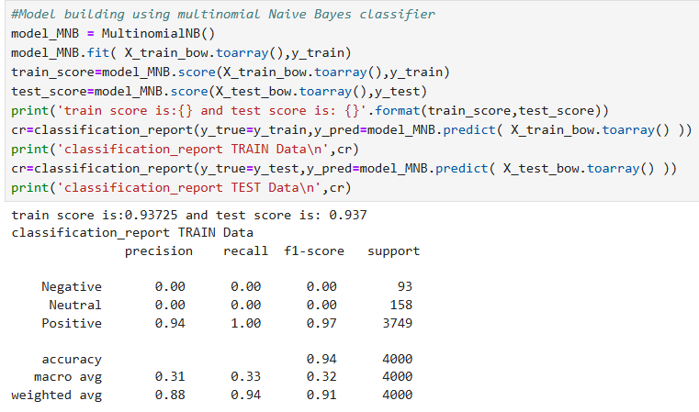
(iv). Feature Engineering:
* Transformed review text into numerical features using TF-IDF Vectorization.
(v). Model Implementation:
* Baseline Model: Implemented Multinomial Naive Bayes as a starting classifier.

Slide 10
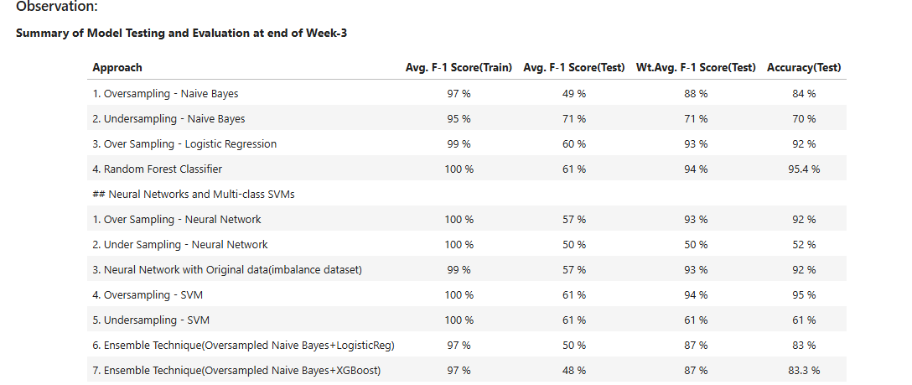
Summary of Model Testing and Evaluation

Slide 11
Chapter - 4
4. Results:
Exploratory Data Analysis (EDA):
* The sentiment distribution revealed class imbalance:
  Positive Reviews: ~93%
  Neutral Reviews: ~4%
  Negative Reviews: ~3%
* Significant patterns identified:
  Negative reviews often highlighted product durability issues.
  Positive reviews frequently mentioned affordability and aesthetics.
2. Class Imbalance Resolution:
* Balancing techniques improved model performance:
SMOTE Oversampling effectively increased recall for minority classes.
Combination Sampling yielded the most balanced predictions.

Slide 12
Chapter - 5
Conclusions
Project Summary:
(a) Conducted sentiment analysis on over 34,000 e-commerce reviews, classifying feedback as Positive, Neutral, or Negative.
(b) Effectively addressed class imbalance challenges using advanced oversampling methods to ensure balanced model training.
(c) Implemented and compared a variety of models—including both traditional machine learning algorithms and advanced neural networks—to identify the most accurate approach for sentiment prediction.

Slide 13
3. Practical Impact:
(a). The results demonstrate the potential of sentiment analysis in understanding customer behavior, addressing product-related concerns, and improving user satisfaction.
(b). Insights gained can guide businesses in targeted marketing, product enhancements, and strategic decision-making.
4. Future Scope:
(a). Expand the dataset to include more diverse products and reviews.
(b). Explore other deep learning architectures, such as BERT or Transformer-based models, for improved performance.
(c). Integrate sentiment analysis results with real-time dashboards for business applications.
Closing Statement
By integrating advanced analytical methods with robust solutions to data challenges, this project establishes a strong framework for applying sentiment analysis to real-world e-commerce environments..

